Slide 1



BINOMIAL HEAP
EXPLANATION
Binomial Heap is an extension of Binary Heap
It provides faster union or merge operation together with other operations provided by Binary Heap.
Binary heap is used to implement priority queue, as seen in the previous sections
“A Binomial Heap is a collection of Binomial Trees”

Slide 2
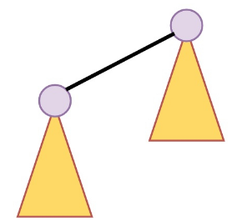
BINOMIAL HEAP
EXPLANATION
A binomial Heap is a collection of Binomial Trees.
A binomial tree Bk is an ordered tree defined recursively.
A binomial Tree B0 is consists of a single node.
A binomial tree Bk is consisting of k binomial trees Bk-1 that are linked together
The root of one is the left most child of the root of the other

Slide 3
BINOMIAL HEAP
PROPERTIES
A Binomial Heap is a set of Binomial Trees where each Binomial Tree follows Min Heap property
There can be at most one Binomial Tree of any degree.
Properties Each binomial tree in H is heap-ordered.
So the key of a node is greater than or equal to the key of its parent.
There is at most one binomial tree in H, whose root has a given degree.

Slide 4
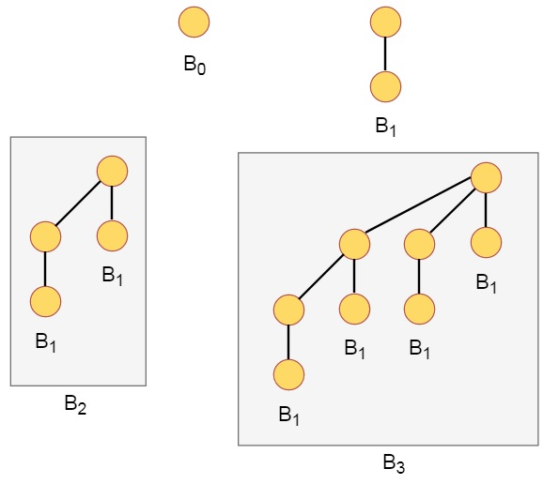
BINOMIAL HEAP
PROPERTIES AND EXAMPLE
A Binomial Tree of order k has following properties.
It has exactly 2^k nodes. It has depth as k.
There are exactly nodes at depth i for i = 0, 1, . . . , k.
The root has degree k and children of root are themselves Binomial Trees with order k-1, k-2,.. 0 from left to right.

Slide 5
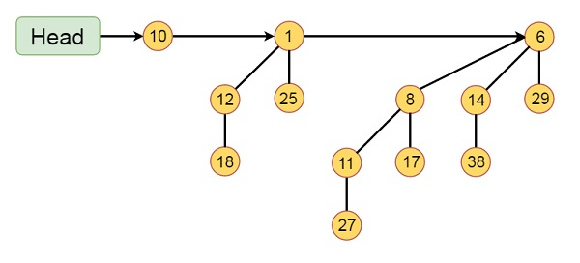
BINOMIAL HEAP
EXAMPLE
This binomial Heap H consists of binomial trees B0, B2 and B3.
They have 1, 4 and 8 nodes respectively. In total n = 13 nodes.
The root of binomial trees are linked by a linked list in order of increasing degree

Slide 6
BINOMIAL HEAP
OPERATIONS
The main operation in Binomial Heap is union()
All other operations mainly use this operation.
The union() operation is to combine two Binomial Heaps into one

Slide 7
BINOMIAL HEAP
OPERATIONS
insert(H, k): Inserts a key ‘k’ to Binomial Heap ‘H’. This operation first creates a Binomial Heap with single key ‘k’, then calls union on H and the new Binomial heap.
getMin(H): A simple way to getMin() is to traverse the list of root of Binomial Trees and return the minimum key.

Slide 8
BINOMIAL HEAP
OPERATIONS
extractMin(H): We first call getMin() to find the minimum key Binomial Tree, then we remove the node and create a new Binomial Heap by connecting all subtrees of the removed minimum node.

Slide 9
BINOMIAL HEAP
OPERATIONS
Finally, we call union() on H and the newly created Binomial Heap. delete(H): Like Binary Heap, delete operation first reduces the key to minus infinite, then calls extractMin(). decreaseKey(H): decreaseKey() is also similar to Binary Heap. We compare the decreases key with it parent and if parent’s key is more, we swap keys and recur for the parent. We stop when we either reach a node whose parent has a smaller key or we hit the root node.

Slide 10
BINOMIAL HEAP
OPERATIONS
Union OperationGiven two Binomial Heaps H1 and H2, union(H1, H2) creates a single Binomial Heap.
The first step is to simply merge the two Heaps in non-decreasing order of degrees.After the simple merge, we need to make sure that there is at most one Binomial Tree of any order.
To do this, we need to combine Binomial Trees of the same order. We traverse the list of merged roots, we keep track of three-pointers, prev, x and next-x.

Slide 11
BINOMIAL HEAP
OPERATIONS
There can be following 4 cases when we traverse the list of roots.
Orders of x and next-x are not same, we simply move ahead.
In following 3 cases orders of x and next-x are same.
If the order of next-next-x is also same, move ahead.
If the key of x is smaller than or equal to the key of next-x, then make next-x as a child of x by linking it with x.
If the key of x is greater, then make x as the child of next. 4

Slide 12
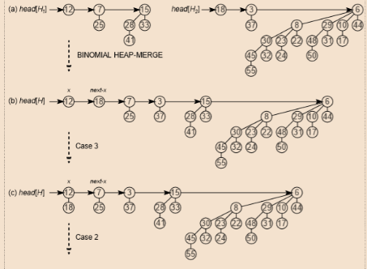
BINOMIAL HEAP
RESULT

Slide 13
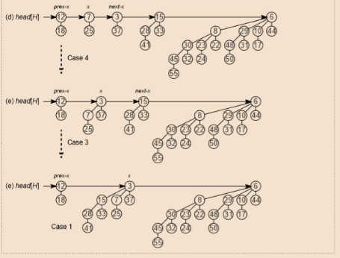
BINOMIAL HEAP
RESULT

Slide 14
INTERVIEW QUESTIONS
1.What is Binomial Heap?
Answer: A binomial heap is a type of data structure used to maintain a collection of elements, typically with a focus on efficient priority queue operations. It is a collection of binomial trees where each tree follows the min-heap property.

Slide 15
INTERVIEW QUESTIONS
2. What are the key operations in a Binomial Heap?
Answer: The key operations in a binomial heap are:
insert(H, k): Inserts a key 'k' into the binomial heap 'H'.
getMin(H): Finds the minimum key in the binomial heap 'H'.
extractMin(H): Removes and returns the minimum key from the binomial heap 'H'.
delete(H): Deletes a specific element from the binomial heap.
decreaseKey(H): Decreases the key of a specific element in the binomial heap.
union(H1, H2): Combines two binomial heaps into one.

Slide 16
INTERVIEW QUESTIONS
3. How does the insert operation work in a Binomial Heap?
Answer: The insert operation in a binomial heap creates a new binomial heap with a single key 'k' and then uses the union operation to merge it with the existing binomial heap.

Slide 17
INTERVIEW QUESTIONS
4. What is the purpose of the union operation in a Binomial Heap?
Answer: The union operation is used to combine two binomial heaps into one. It involves merging the two heaps in non-decreasing order of their degrees and then combining binomial trees of the same degree to ensure that there is at most one binomial tree of any order in the heap.

Slide 18
INTERVIEW QUESTIONS
5. How does the decreaseKey operation work in a Binomial Heap?
Answer: The decreaseKey operation compares the decreased key with its parent and swaps keys recursively until it reaches a node whose parent has a smaller key or the root node.

Slide 19
INTERVIEW QUESTIONS
6. What is the Min Heap property, and how does it apply to a Binomial Heap?
Answer: The Min Heap property states that the key of a node is greater than or equal to the key of its parent. In a binomial heap, each binomial tree follows the Min Heap property, and the root of the entire heap is the minimum key among all the trees.

Slide 20
INTERVIEW QUESTIONS
7. Explain the process of extracting the minimum key in a Binomial Heap.
Answer: To extract the minimum key in a binomial heap, we first call the getMin operation to find the minimum key binomial tree. Then, we remove the node with the minimum key and create a new binomial heap by connecting all the subtrees of the removed node. Finally, we call the union operation on the original heap and the newly created heap.

Slide 21
INTERVIEW QUESTIONS
8. What are the properties of a Binomial Heap?
Answer: The properties of a binomial heap are:
Each binomial tree in the heap is heap-ordered (follows the Min Heap property).
There is at most one binomial tree with a given degree in the heap.

Slide 22
INTERVIEW QUESTIONS
9. Can you compare a Binomial Heap to a Binary Heap?
Answer: Binomial heaps have certain advantages over binary heaps, such as faster union and decrease key operations. They can be used for priority queue operations efficiently. However, binary heaps are easier to implement and have better average time complexity for some operations.

